Slide 1
GaN Devices and
Chip on Board design
Submitted to :
Mr. Roshish Gupta Scientist/Engineer SE
VTAD
SCL
Submitted by :
Samvrit Kala IIT Ropar

Slide 2
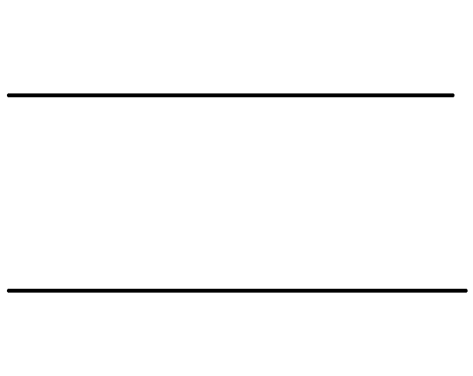
Gallium Nitride (GaN)
Conduction Band
3.4eV
Valence Band
Gallium nitride is a binary, polar III/V band gap semiconductor.
Crystal Structure:
Most commonly wurtzite (asymmetric hexagonal) structure (stable at room temp).
Also exists in cubic form (metastable).
Band Gap: 3.4 eV (direct band gap)
Lattice Parameters (wurtzite):
a=3.189 Å
c=5.185 Å
GaN

Slide 3
Aluminium Gallium Nitride (AlₓGa₁₋ₓN)
Ternary compound alloy of AlN and GaN, with mole fraction X of aluminum and (1-X) of gallium
Crystal Structure:
Typically wurtzite, same as GaN (when grown epitaxially on GaN)
Band Gap:
Varies nonlinearly from 3.4 eV (GaN) to 6.2 eV (AlN) depending on Al mole fraction X:
The bandgap follows non-linearity due to bowing effect.
Lattice Parameters [Vegard’s Law]
a = x ⋅ 3.112 Å + (1−x) ⋅ 3.189 Å
c = x ⋅ 4.982 Å + (1−x) ⋅ 5.185 Å

Slide 4
HETERO-JUNCTIONS
A heterojunction is a junction formed between two different semiconductor materials with different bandgaps, electron affinities, or lattice constants.
Unlike a homojunction (same material), heterojunctions allow greater control over band alignment, carrier transport, and charge confinement.
Enable band engineering for improved device performance
Allow formation of quantum wells, 2DEGs, and carrier confinement
Essential in high-speed and high-power devices like HEMTs (High Electron Mobility Transistors), HBTs (Heterojunction Bipolar Transistors), LEDs and laser diodes

Slide 5
HETERO-JUNCTIONS FORMATION
To make a high-quality heterojunction, there are rules like:
Lattice matching: The two semiconductor materials should have similar lattice constants to avoid defects. If the mismatch is too large, it causes lattice strains, dislocations and degrades device performance. However, lattice strain can also be used intentionally to engineer better mobility or band structure, as long as the strained layer remains thin and below the critical thickness.
The layers must be grown epitaxially, meaning atom-by-atom growth that follows the crystal structure of the substrate. A planar and uniform crystalline interface is essential for efficient carrier transport and reliable operation.

Slide 6
HETERO-JUNCTIONS FORMATION
3. To achieve such precise layers, techniques like MOCVD (Metal-Organic Chemical Vapor Deposition) and MBE (Molecular Beam Epitaxy) are used. These allow atomic-level control of composition and thickness, which is critical in bandgap engineering and doping profiles.
4. Finally, the interface must be clean and sharp. Any contamination or roughness introduces traps and scattering centers. Good thermal and chemical compatibility also ensures that the materials do not degrade during high-temperature growth.

Slide 7
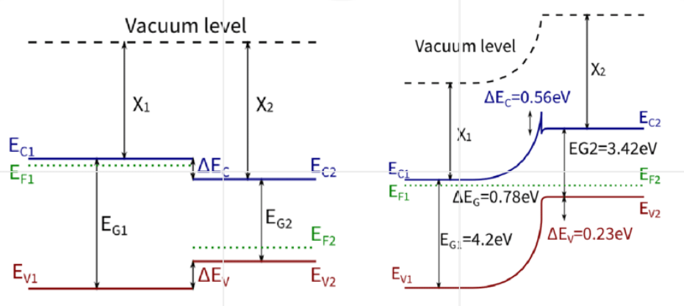

GaN band diagram
First band diagram shows the isolated band structures of two semiconductors: AlGaN (left) and GaN (right), with band gaps E_{G1} and E_{G2}​
There is no contact yet.
Second band diagram shows the band alignment after contact, where Fermi levels equalize, creating band bending and charge redistribution.

Slide 8
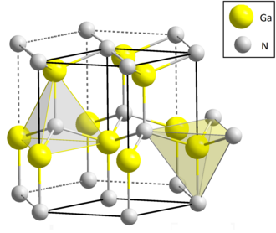
Polarization in GaN (Spontaneous)
GaN is a polar material primarily due to two reasons:
The difference in electronegativity between gallium (Ga) and nitrogen (N)
Non-centrosymmetric wurtzite crystal structure : The wurtzite structure of GaN is hexagonal but asymmetric along the c-axis (Z-direction), meaning the stacking of atoms lacks mirror symmetry. As a result, the dipole moments in the unit cell align from Ga to N, which defines the direction of the polarization vector.

Slide 9
Polarization in GaN (Spontaneous)
There develops a net spontaneous polarization along the Z-axis in both AlₓGa₁₋ₓN as well as GaN
For GaN, the spontaneous polarization is –0.029 C/m²,
For AlN, the spontaneous polarization is –0.081 C/m².
The negative signs indicate the direction of polarization is from the substrate (bottom) toward the surface (top)
In Ga-polar orientation, there is negative charge accumulation at the top surface and positive charge at the bottom. This built-in electric field (from bottom to top) affects the energy bands, pulling the conduction band downward.
Conversely, in N-polar GaN, the direction of polarization and surface charges would reverse, significantly altering the electric field and device behavior.
Negative charge accumulated
- - - - - - - - - - - - - - - - - - - - - -
AlₓGa₁₋ₓN / AlN / GaN Layer
+ + + + + + + + + + + + + + + + + + + + + +
Positive charge accumulated
Spontaneous polarization

Slide 10
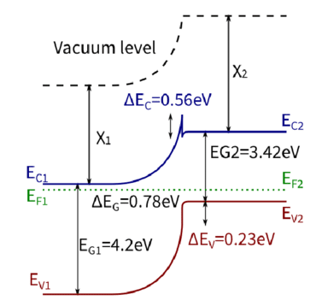
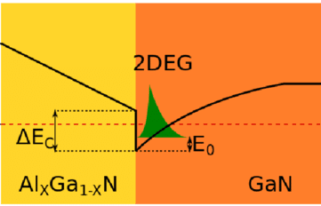
Polarization in GaN (Spontaneous)
The built-in electric field (from bottom to top) affects the energy bands, pulling the conduction band downward. As a result, in structures like AlGaN/GaN HEMTs, this field bends the conduction band below the Fermi level over a depth of around 20–22 nm, leading to the formation of a quantum well and 2DEG at the interface.
Once the conduction band bottom crosses the Fermi level, the band tends to flatten, as further band bending is screened by the accumulated free electrons, thus justifying the mechanism of 2DEG formation in Ga-polar GaN structures.

Slide 11
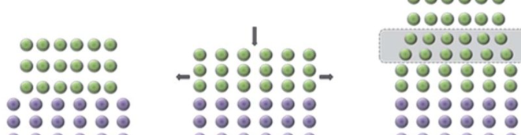
Piezoelectric polarization
Piezoelectric polarization arises in addition to spontaneous polarization due to strain at the heterojunction.
AlGaN has a smaller lattice constant than GaN, when a thin AlGaN layer is grown on a thick GaN substrate, it experiences tensile strain to match the underlying GaN. This tensile strain distorts the crystal structure and induces piezoelectric polarization in the same direction as the spontaneous polarization. The polarity aligns because stretching the AlGaN layer further shifts the centers of positive and negative charge in the same direction as the natural dipole moment of the wurtzite lattice.
Tensile strain

Slide 12
Piezoelectric polarization
The strength of piezoelectric polarization increases with strain, but only up to a point. If the AlGaN layer becomes too thick, the accumulated strain energy exceeds the critical thickness, leading to cracks or dislocations that relax the strain.
AlGaN layers are kept below 25–30 nm to avoid such issues, while the thick GaN substrate remains relaxed and unstrained.
Negative charge accumulated
- - - - - - - - - - - - - - - - - - - - - -
AlₓGa₁₋ₓN Layer
+ + + + + + + + + + + + + + + + + + + + + +
Positive charge accumulated
Spontaneous as well as piezoelectric polarization
When both spontaneous and piezoelectric polarizations are aligned, their effects add up, reinforcing the built-in electric field at the interface. This enhanced field increases conduction band bending, deepens the quantum well, and boosts 2DEG concentration, which is critical for the high performance of GaN HEMT

Slide 13
GaN layers after polarization
The positive polarization charge at the bottom of the GaN layer due to spontaneous and piezoelectric polarizations is often screened out by the conducting substrate or a thick GaN buffer layer, and thus doesn't significantly affect the device physics.
The AlGaN layer contributes positive polarization charges at its lower interface (due to its own spontaneous and piezoelectric polarization), while the GaN layer contributes negative polarization charges at its upper interface (due to its spontaneous polarization).
- - - - - - - - - - - - - - - - - - - - - -
AlₓGa₁₋ₓN Layer
+ + + + + + + + + + + + + + + + + + + + + +
- - - - - - - - - - - - - - - - - - - - - -
GaN Layer
+ + + + + + + + + + + + + + + + + + + + + +
Sapphire / SiC / Si substrate

Slide 14
GaN layers after polarization
At the top surface of the AlGaN layer, there's a net negative polarization charge, which is balanced by free positive charges due to presence of dangling bonds, adsorbed moisture, and surface states, collectively referred to as surface donors. These surface donors act as positive charges that accumulate at the surface and partially neutralize the negative polarization charge of AlGaN.
- - - - - - - - - - - - - - - - - - - - - -
AlₓGa₁₋ₓN Layer
+ + + + + + + + + + + + + + + + + + + + + +
- - - - - - - - - - - - - - - - - - - - - -
GaN Layer
+ + + + + + + + + + + + + + + + + + + + + +
Sapphire / SiC / Si substrate

Slide 15
GaN layers
Charge density
+qN_{d}
+σ_{top}
-σ_{top}
d
-qn_{s} (2DEG)
There remains a net positive fixed charge accumulates at the top surface of the GaN layer, just below the AlGaN.
As a result, a net dipole layer forms: a positively charged sheet of atoms or donor-like states at the top of the AlGaN, and a high-density negative sheet of electrons just beneath it, confined at the AlGaN/GaN interface. This is the 2DEG. This charge separation forms a built-in electric field that is essential for the operation of the HEMT, and the electron layer remains confined in the quantum well due to this field and band bending, without the need for intentional doping.

Slide 16
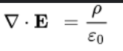
GaN layers
Charge density
+qN_{d}
+σ_{top}
-σ_{top}
d
-qn_{s} (2DEG)
Electric field
d
-E

Slide 17
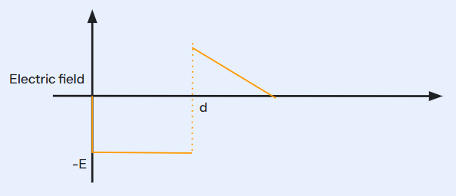
GaN layers
The discontinuity arises as the band gap of GaN is smaller than AlGaN.
The electric field causes the conduction band and valence band edges to bend up or down.

Slide 18
2DEG FORMATION
In a HEMT (like AlGaN/GaN), a 2DEG (two-dimensional electron gas) forms at the interface between two semiconductors with different band gaps typically a wide bandgap material (like AlGaN) on top of a narrower bandgap material (like GaN).
At this heterojunction, due to polarization effects and band alignment, the conduction band in the GaN layer bends downward near the interface and forms a dip.
When the conduction band edge dips below the Fermi level, electrons start to accumulate in that region because it's energetically favorable for them to occupy those states.
Since the electrons are confined in a very thin layer at the interface and cannot move vertically, they are effectively trapped in a triangular quantum well, forming a 2D electron system.

Slide 19
GaN depletion mode
p GaN
p-GaN means p-type GaN, which is created by doping GaN with acceptor atoms (typically Magnesium, Mg) to create holes as majority carriers.
A thin p-GaN layer is placed on top of the AlGaN/GaN structure
This layer blocks the formation of the 2DEG unless a positive gate voltage is applied.
The device becomes:
Normally OFF (Enhancement-mode)
Gate threshold voltage is positive, typically around +1.5V
GaN is normally ON
Normally ON (Depletion-mode): The channel conducts even with 0V gate bias, and you need to apply a negative gate voltage to turn it OFF.
This is undesirable in many circuits due to safety concerns (device conducts unintentionally at startup).

Slide 20
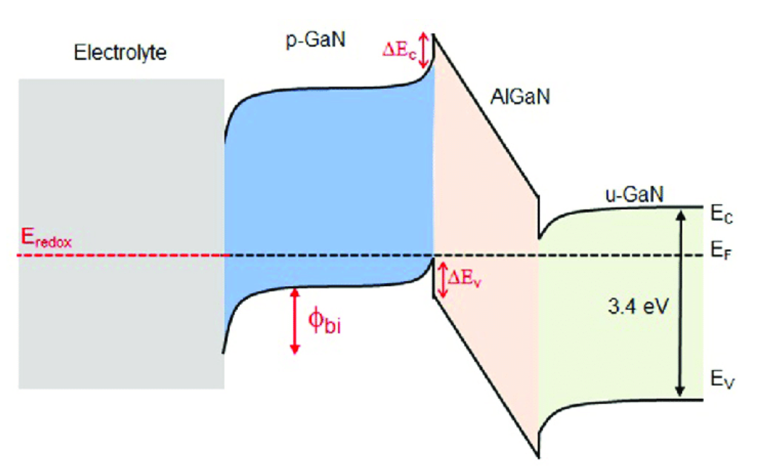
p GaN
Date
Doping GaN with acceptor atoms (typically Magnesium, Mg) to create holes as majority carriers and makes p-GaN HEMTs safer and more convenient for use in power switching applications like EVs, power adapters, data centers

Slide 21
GDS (Graphic Data System) file
A GDS file, also known as a GDSII file, is a binary file format used to store integrated circuit (IC) layout data, including geometric shapes, text labels, and other related information. It's the industry standard for exchanging IC layout artwork and is commonly used as the final output from the IC design cycle, sent to foundries for chip manufacturing.
Key Characteristics:
Binary Format: GDS files store data in a binary format, making them efficient for storing and transferring layout information.
Hierarchical Structure: The data within a GDS file is organized hierarchically, meaning it can represent complex designs with nested structures and elements.
Standard for IC Layouts: GDS is the widely adopted standard for exchanging layout data between different Electronic Design Automation (EDA) tools and for transferring designs to foundries for fabrication.

Slide 22
GDS file
Components:
GDS files contain information about layers, geometric shapes (like polygons and rectangles), text labels, and other relevant data used to define the physical layout of an integrated circuit.
GDS files are typically the last step in the IC design flow, representing the final, verified layout ready for manufacturing.
Manufacturing use
IC designers use EDA tools (like Cadence Virtuoso or Mentor Graphics Calibre) to create the layout of an integrated circuit, which is then saved in GDS format.
The GDS file is then used to transfer the layout data to other tools for verification or to foundries for fabrication.
Mask Generation: Foundries use the GDS file to create photomasks, which are used in the chip manufacturing process.
In essence, a GDS file acts as a blueprint for creating physical chips, ensuring that the layout data is accurately represented and transferred between different stages of the design and manufacturing process

Slide 23
GBR (Gerber) file
A GBR file, commonly known as a Gerber file, is the industry standard for communicating Printed Circuit Board (PCB) design data for manufacturing. Similar to how a GDSII file acts as a blueprint for Integrated Circuits, a Gerber file serves as the detailed instruction set for fabricating a PCB.
Characteristics:
ASCII Vector Format: Gerber files are open, ASCII (human-readable text) vector formats. They contain commands and coordinates that describe geometric shapes, much like a plotting language. This makes them relatively easy to inspect and debug, although specialized viewers are typically used for a proper visual representation.
Layer-Specific: A key characteristic of Gerber files is that they represent each layer of the PCB individually. For example, a typical two-layer PCB design will result in multiple Gerber files: top copper layer, bottom copper layer, top solder mask, bottom solder mask, top and bottom silkscreen, and often a separate file for drill hole data (often in Excellon format, which complements Gerber).

Slide 24
GBR file
De Facto Standard for PCBs: The Gerber format is the widely adopted standard for exchanging PCB layout data between Electronic Design Automation (EDA) tools (like Altium Designer, KiCad, Eagle, Cadence Allegro) and PCB manufacturers (fabrication houses).
Contains Imaging and Manufacturing Data: GBR files define various elements of a PCB, including:
Copper layers: Traces, pads, and copper pours.
Solder mask layers: Areas where solder resist is applied.
Silkscreen layers: Text, logos, and component outlines for assembly and identification.
Board outline: The physical shape and dimensions of the PCB, including any cutouts or slots.
A separate drill file is almost always included, specifying the location, size, and type (plated/non-plated) of all holes.

Slide 25
GBR file
Manufacturing use
Design Export: PCB designers use EDA/CAD software to create the layout of a printed circuit board. Once the design is complete and verified, the software exports the various layers of the PCB into individual Gerber files.
Data Package for Fabrication: The collection of Gerber files (and the associated drill file) forms a complete manufacturing data package. This package is then sent to a PCB fabrication house.
Manufacturing Instructions: PCB manufacturers feed these Gerber files into their Computer-Aided Manufacturing (CAM) systems. These systems interpret the commands and coordinates in the Gerber files to control various automated machines:
Photoplotters or Direct Imagers: Used to create the photographic masks or directly expose the photoresist on the copper-clad laminates, defining the copper traces and pads.
Drilling Machines: Utilize the drill file to precisely drill holes for vias, component leads, and mounting.
Solder Mask and Silkscreen Printers: Apply the solder mask and silkscreen layers according to the Gerber data.

Slide 26
GBR file
Quality Control and Verification: Gerber files are also used for Automated Optical Inspection (AOI) to verify the accuracy of the manufactured boards against the design. Gerber viewers are essential tools for both designers and manufacturers to visually inspect the layers and ensure correctness before and during production.
In essence, a GBR file serves as the precise digital blueprint for manufacturing a physical Printed Circuit Board, translating the electronic design into tangible layers that are then stacked and processed to create the final circuit board.

Slide 27
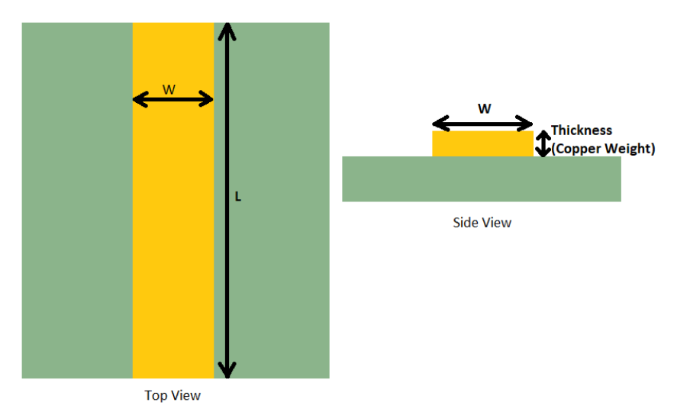
Copper thickness (oz/ft²)
In the PCB industry, copper thickness is commonly expressed in ounces (oz) a unit of weight.
When 1 ounce (28.35 grams) of copper is rolled flat to cover an area of 1 square foot (0.093 sq meters), the resulting foil thickness works out to 1.37 thousandths of an inch (mils). In metric units, 1 oz/ft² copper equals 0.0348mm.
1 oz/ft² = 0.035mm
Heavier copper allows higher current or narrower traces for the same current without overheating, but it also affects etching precision.

Slide 28
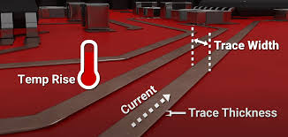
Trace width
Trace width is the thickness or width of a copper track on a PCB that carries current. It’s important because narrow traces can overheat if too much current flows through them. The required trace width depends on the current capacity, copper thickness, and temperature rise allowed.
It is usually measured in mils
1 mil = 0.001 inches = 0.025 mm

Slide 29
Trace Width
The trace width and current relationship in PCBs is influenced by several factors:
Current Carrying Capacity
Temperature Rise: This can destroy the working circuit if not taken care of.
Copper Thickness: Copper trace layer with the largest thickness is then preferable as it offers better conductivity and higher current.
Trace Length: Longer trace offer more resistance and produce more heat
Ambient Temperature: The thermodynamic performance of the structure decrements due to high temperature surrounding it. So the structure is not able to emit heat properly
Layer Placement: Outward heat loss dissipates faster than the inner surface.
Thermal Pathways: Surface mount items, including thermal vias and heat sinks, can provide a means of more effective temperature sag.

Slide 30
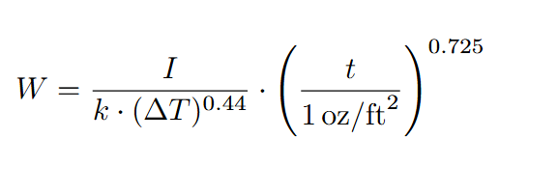
Trace Width calculation
Trace Width is calculated as
Where I = current that can pass through it
ΔT = increase in temperature in °C)
t = thickness of copper traces 2 oz/ft²
Constant K = 0.048 (external layer)
0.024 (internal layer)

Slide 31
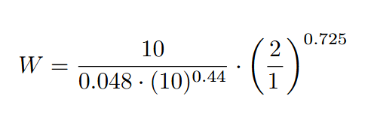
Trace Width calculation
Trace Width is calculated as
For I=10A; ΔT=10∘C
W = 120 mils = 3.048mm

Slide 32
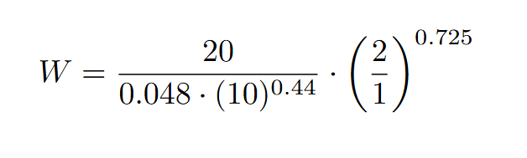
Trace Width calculation
Trace Width is calculated as
For I=20A; ΔT=10∘C
W = 240 mils = 6.096mm

Slide 33
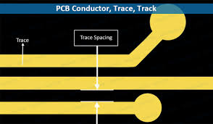
Trace spacing
Trace spacing is the distance between two adjacent copper traces on a PCB. It’s important for electrical isolation if traces are too close, voltage breakdown or arcing may occur, especially at high voltages. It also affects crosstalk and EMI.
Spacing is measured in mils or mm.

Slide 34
Trace spacing
The following key points highlight the importance of trace spacing design rules in electronic circuit design.
Electrical Safety: By maintaining suitable trace spacing, it becomes possible to avoid arcing between high voltage traces, thus guaranteeing circuit safety and decreasing the probability of electrical hazards.
Signal Integrity: Adequate spacing between traces reduces crosstalk, minimizing the interference between signals and maintaining signal integrity. This is crucial for high-speed digital and analog circuits.
Impedance Control: By following trace spacing design rules, designers can achieve the desired impedance for transmission lines, ensuring optimal signal quality and reducing reflections.
Manufacturing Reliability: Design rules for trace spacing take into account the capabilities and tolerances of the PCB fabrication process. Following these guidelines guarantees the precise and dependable manufacture of the PCB, thereby decreasing the possibility of manufacturing defects.

Slide 35
Trace spacing
EMI/EMC Compliance: Proper trace spacing helps in minimizing electromagnetic interference (EMI) and achieving electromagnetic compatibility (EMC) compliance.
Heat Dissipation: Adequate spacing between power traces and other components helps in efficient heat dissipation, preventing thermal issues and ensuring the reliability of the circuit.
Design for Manufacturing (DFM): Reducing the chances of short circuits, opens, or other manufacturing-related issues.
Design for Testability (DFT): Proper trace spacing allows for easier probing and testing of the PCB during the manufacturing and debugging stages, improving testability and reducing the time required for troubleshooting.
Design for Serviceability: Adequate spacing between traces makes it easier to access and repair components on the PCB, enhancing the serviceability and maintenance of the circuit.
Design Consistency: Following trace spacing design rules ensures consistency in PCB layout, making it easier for multiple designers or teams to collaborate on a project and reducing the chances of errors or inconsistencies.

Slide 36
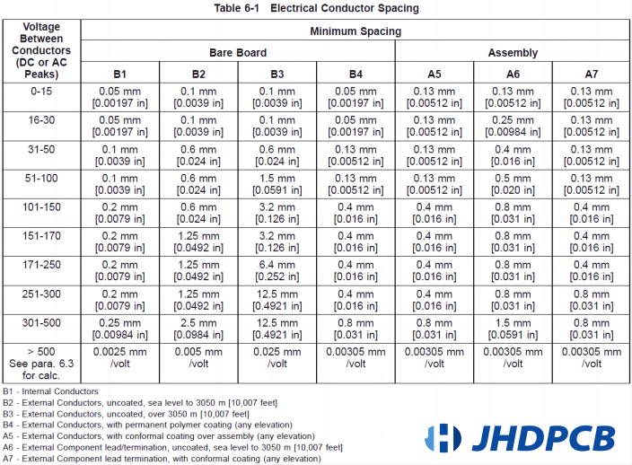
Trace spacing
We chose B4: External Conductors with permanent polymer coating (any elevation) because our design includes coated external traces.
For voltage as high as 1000V, the required trace spacing is calculated as:
0.00305 mm/Volt×1000 V
=3.05 mm

Slide 37
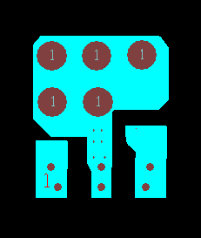
COBs designed
In the OrCAD design, the blue regions represent the top copper layer, which carries the main signal and power traces. A similar red bottom copper layer (not shown here) exists to mirror and support routing and thermal conductivity.
The grey circular features are vias or plated through holes (PTHs), which serve two purposes: electrical interconnection between layers and enhanced heat dissipation by conducting thermal energy from the top layer down to the bottom copper and the PCB substrate.
This multilayer approach ensures efficient routing and helps manage the thermal load of the GaN device during operation.

Slide 38
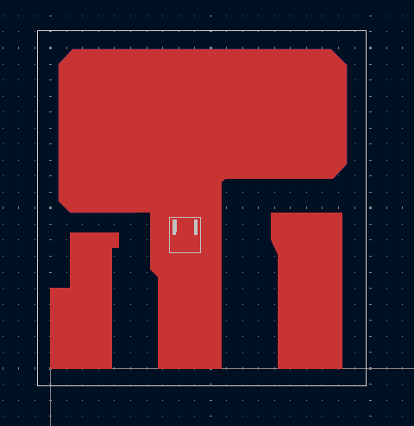
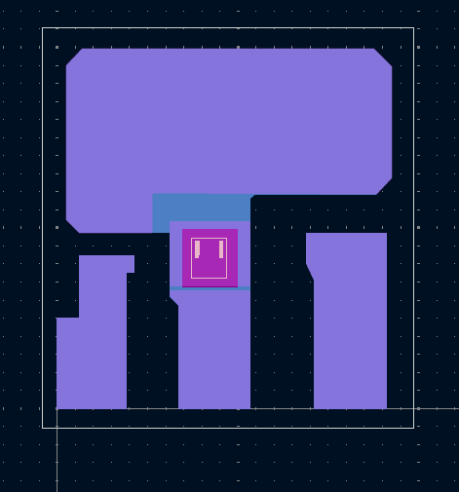
COBs designed
Top Copper layer
Bottom copper layer
GaN Die

Slide 39
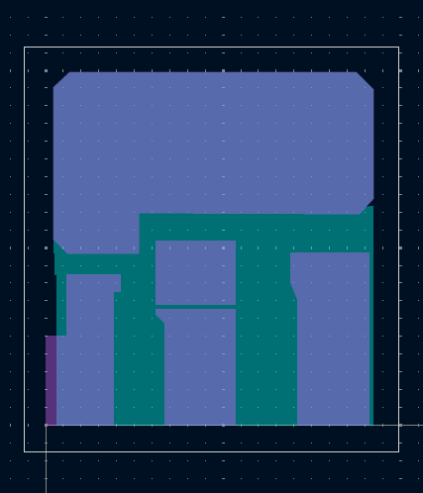
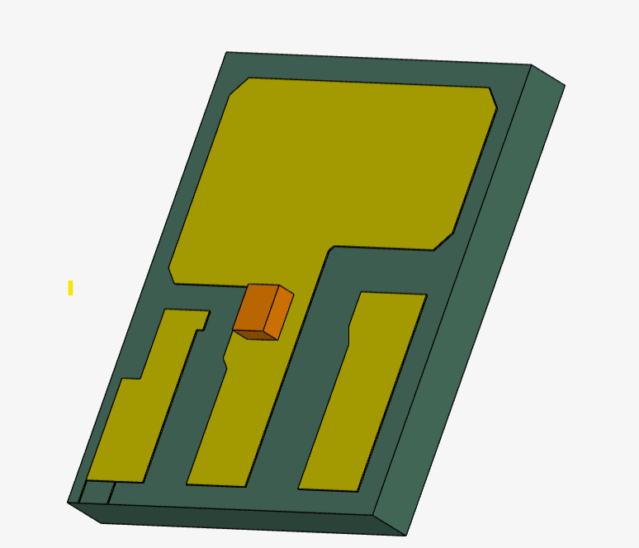
COBs designed
Top Solder Mask layer
Front view
Bottom Solder Mask layer

Slide 40
COBs designed
Top Solder Mask layer
Front view
Bottom Solder Mask layer

Slide 41
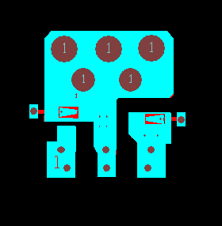
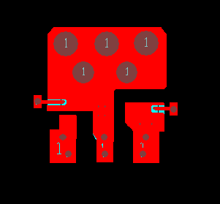
COBs designed other variants
G
S
D
G
S
D
Top copper layer
Bottom copper layer

Slide 42
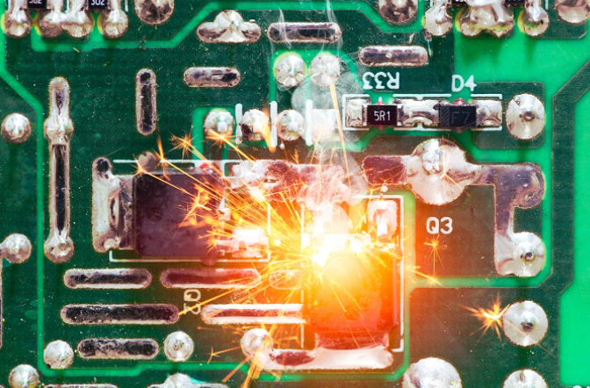
Problems in high current PCB designing
Excess Heat and Electrostatic Energy: High-current boards generate excess heat and electrostatic energy. This can lead to design failures.
Trace Damage: Insufficient metal in power planes can cause traces to burn out. That is why we require thick traces

Slide 43
Problems in high current PCB designing
3. Low Inductance Requirement: Maintaining low inductance at the power supply is difficult. If not maintained, more decoupling capacitors are needed to restore balance.
4. Thermal Management: Crucial for preventing structural failures of the PCB.
Example: FR-4 material has a transition temperature (Tg) of 130°C.
Above this temperature, it loses stability and starts melting.
Even before this point, traces can melt, causing open or short circuits.
5.Electromagnetic Interference (EMI):
High current can generate strong EMI, affecting nearby circuits and signal integrity.
Proper shielding and layout strategies are required to minimize EMI effects.

Slide 44
Heat dissipation techniques
There are various design techniques for managing heat within PCBs, depending on design constraints, environmental conditions, and the power density of the application.
1) High Thermal Conductivity Prepreg and Dielectric Materials: Advanced prepreg materials with enhanced thermal conductivities are used to optimize heat flow within the PCB.
2) Thick Copper Layers: Increasing the copper weight on internal and external layers (e.g. 2 oz to 4 oz) allows for higher current carrying capacity and improved heat spreading. This is crucial for power electronics and high-current designs where Joule heating must be minimized.

Slide 45
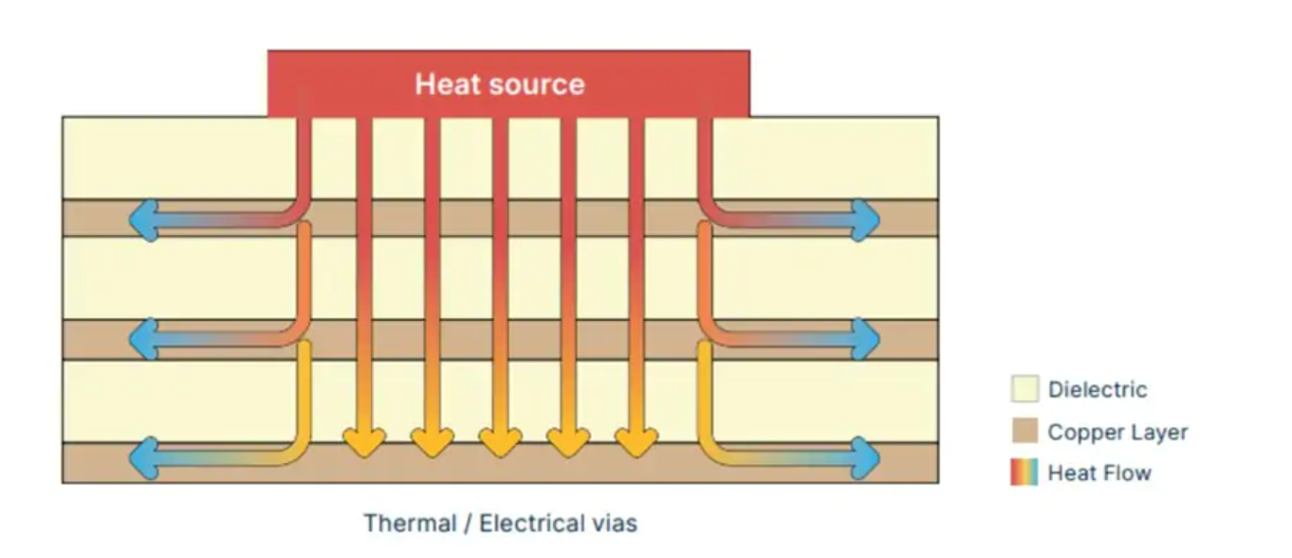
Heat dissipation techniques
3) Via Array: Thermal vias provide vertical heat transfer paths from internal components to external heat sinks. This technique is particularly effective when combined with bottom-side heat sinks.

Slide 46
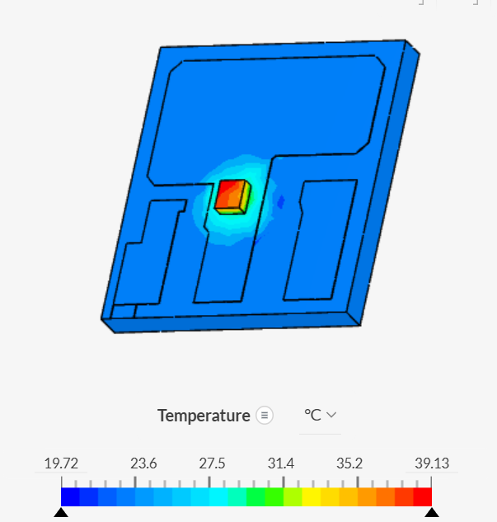
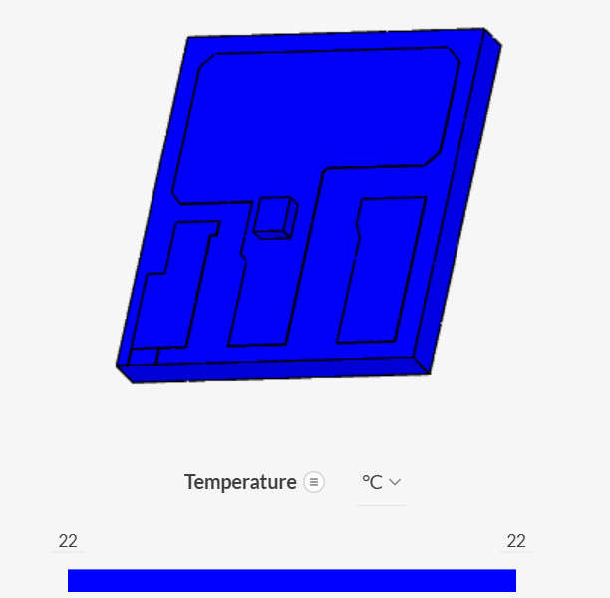
Simulation without Vias
After 0.01s

Slide 47
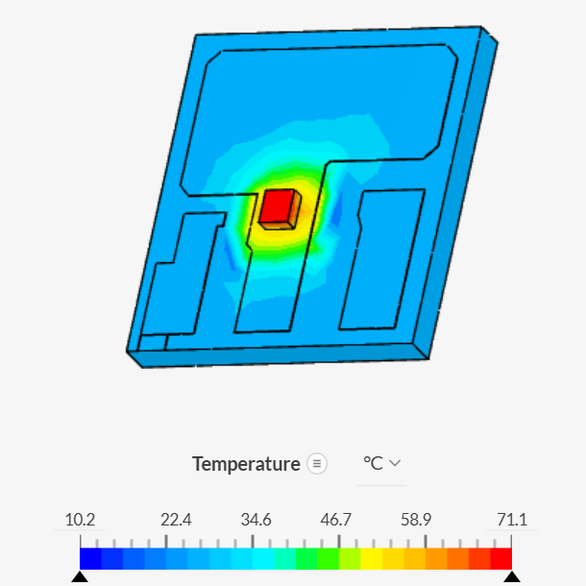
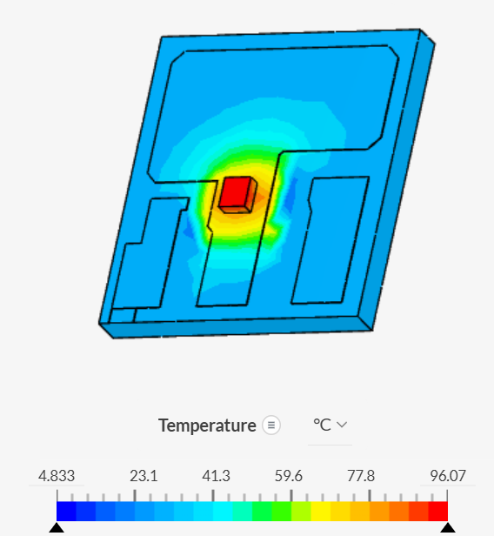
Simulation without Vias
After 0.05s
After 0.1s

Slide 48
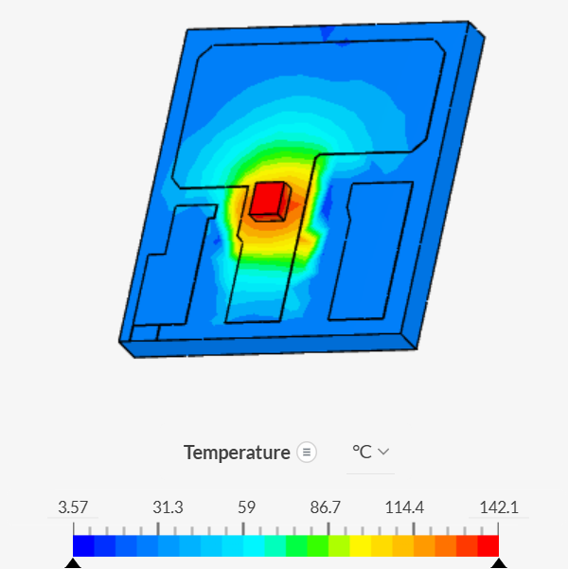
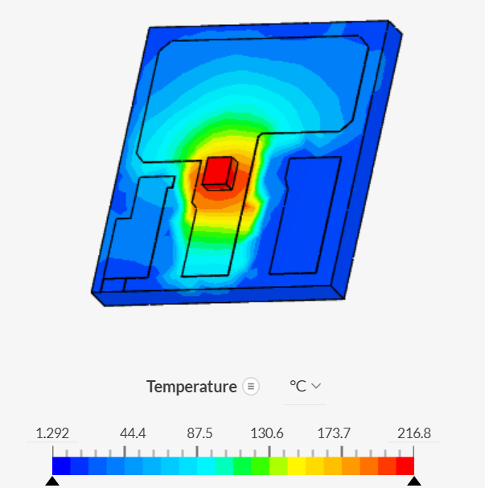
Simulation without Vias
After 0.2s
After 0.5s

Slide 49
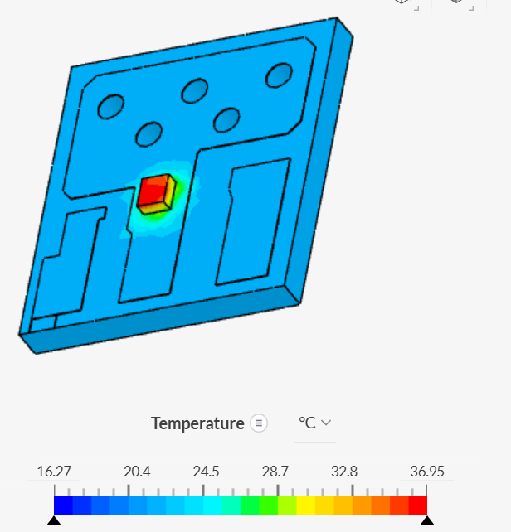
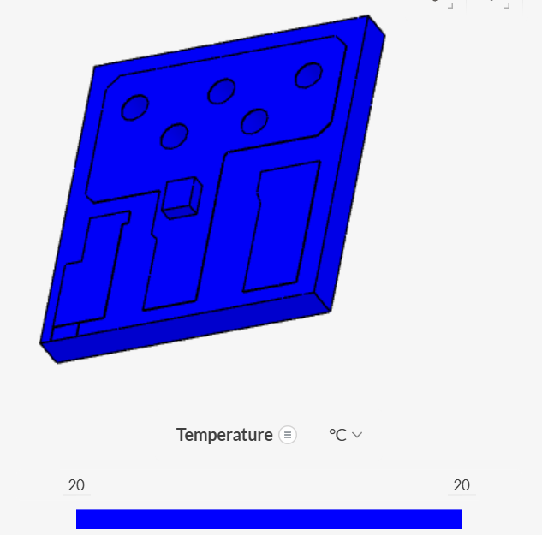
Simulation with Vias
After 0.01s

Slide 50
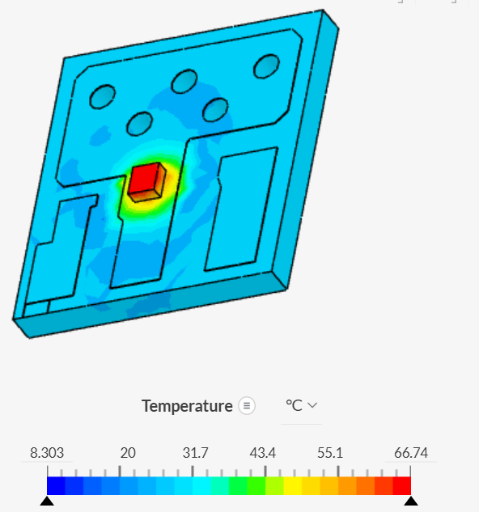
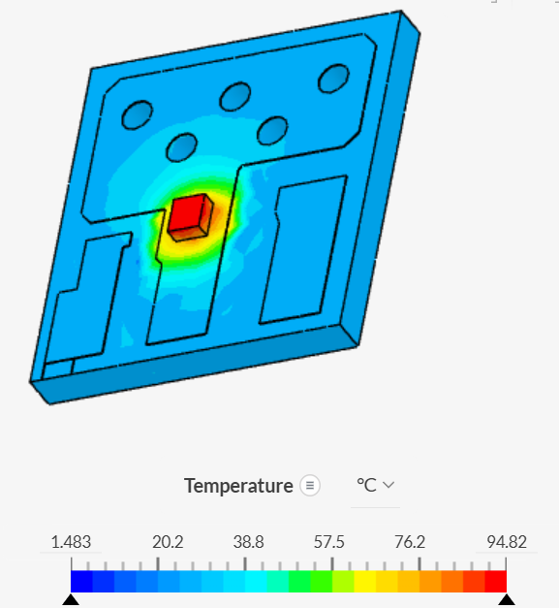
Simulation with Vias
After 0.05s
After 0.1s

Slide 51
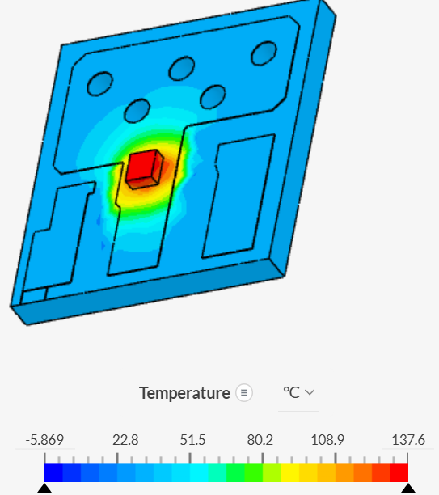
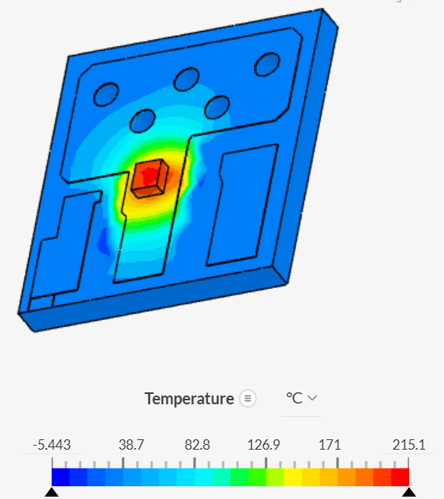
Simulation with Vias
After 0.2s
After 0.5s

Slide 52
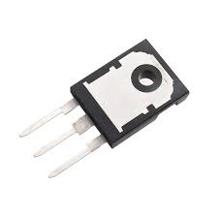
Heat dissipation techniques
4) Post-Bonded Metal Backing: A thick metal plate, often copper or aluminum, is bonded to the PCB’s backside after fabrication. This enhances both thermal mass and spreading, and is suitable for boards with asymmetrical heating or where large-area dissipation is needed. Thermal adhesives offer stable performance across a wide range of operating temperatures and are effective in rigid and rigid-flex PCB configurations.

Slide 53
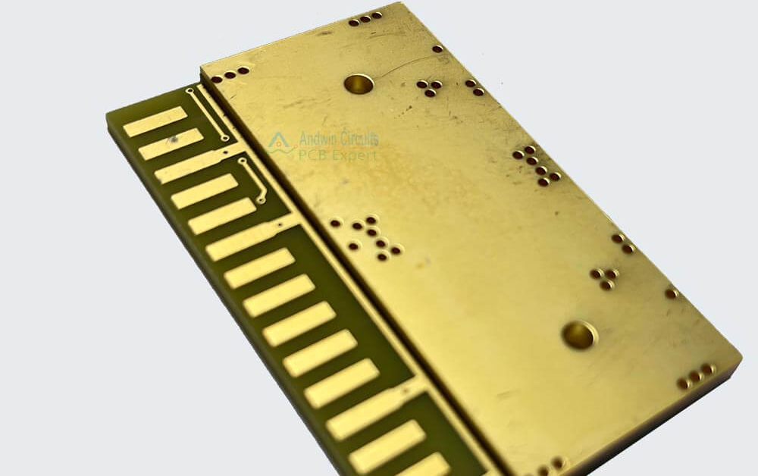
Heat dissipation techniques
5) Embedded metal layers (Internal solution) Embedded metal layers are internal, usually, copper or aluminum planes integrated within the PCB stack-up to enhance in-plane heat spreading and vertical heat conduction.
6) Embedded Metal Coins (T-coin, I-coin, U-coin) Metal coins, typically made of copper or aluminum, are embedded within the PCB stack-up directly beneath heat-generating components. They function as localized thermal spreaders, quickly conducting heat away from critical areas. The shape and size of the coin (T, I, or U profiles) are selected based on thermal simulation and board layout constraints

Slide 54
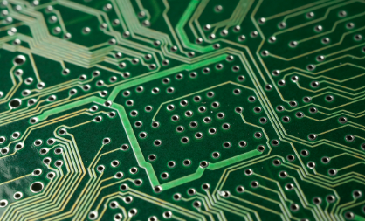
Vias stitching
Vias are essential conductive pathways that interconnect different layers of a printed circuit board (PCB).They help in :
1. Power Distribution Through Multiple Layers
High-current PCBs often need to route large amounts of power across the board. A single layer might not offer sufficient copper width to carry this current. Multiple layers connected by vias allows power to be distributed effectively, reducing trace resistance and voltage drop.
Short and wide traces combined with via stitching lower inductance and electromagnetic interference (EMI).

Slide 55
Vias stitching
2. Grounding and EMI Shielding: Via stitching is used to tie copper pours or ground fills to internal/external ground layers. This creates parallel paths of low resistance and inductance.
3. Heat Dissipation and Thermal Management
High-current traces generate a significant amount of heat. If not dissipated properly, this can damage components.
Thermal vias connect hot areas to internal copper planes or external heat sinks, providing thermal pathways to spread and remove heat.
4. Mechanical Strength
Vias add structural integrity to multilayer boards, especially in areas with large copper pours or high-current traces.
They help reduce flexing and delamination, particularly important for boards subject to vibration or mechanical stress.

Slide 56
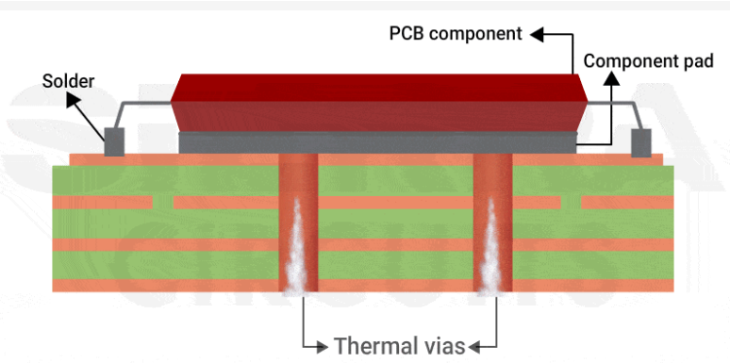
Via-in-pad
A via-in-pad is a via placed directly beneath a component pad, often under heat-generating chips.
It allows direct heat transfer from the component to internal or bottom copper layers.
Mainly through conduction but also helps convection when heat reaches heatsinks.

Slide 57
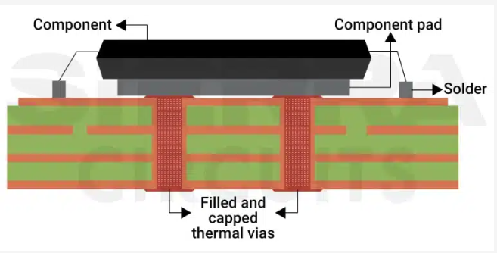
Filled vias
Filled vias are vias that are filled with conductive or non-conductive materials, often plated over to seal the surface.
Heat dissipation primarily through conduction, specially if filled with metals (like copper or silver).

Slide 58
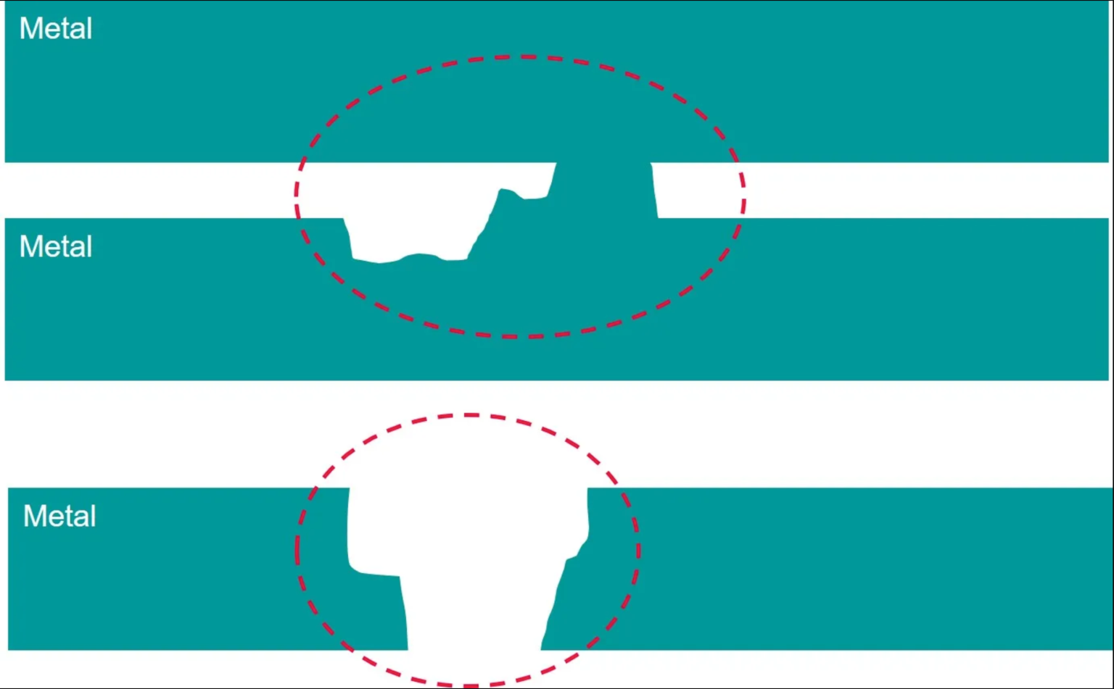
Electromigration in Copper
Electromigration is the mass transport of metal atoms caused by the electron wind from current flowing through a conductor, typically copper. When current density is high enough, metal will diffuse due to current flow, creating tiny hillocks downstream and leaving behind vacancies or voids. With enough electromigration, failures occur due to severe line thinning, causing opens, or due to hillocks that bridge adjacent lines, causing short circuits.

Slide 59
Electromigration in Copper
This is especially critical in fine copper traces, narrow vias, or high-current paths and common in COB and power electronics.
It causes
Material thinning
Build-up elsewhere
Open or short circuits.
Its solution is ENIG finish

Slide 60
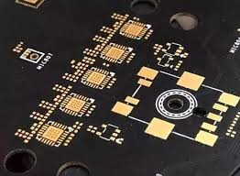
Electroless Nickel Immersion Gold
ENIG is a widely used PCB surface finish that consists of a layer of electroless nickel covered by a thin layer of immersion gold..
The nickel provides a hard, solderable surface and acts as a barrier to the copper and prevent electromigration
The gold layer protects the nickel from oxidation before soldering. It also prevents copper exposure, reducing surface electromigration.
Inside vias, the finish improves resistance to corrosion and current-induced damage.
ENIG also helps maintain stable contact resistance, especially in high-frequency or high-current nodes.
ENIG is specially valued for its flat, smooth surface and excellent shelf life and lead-free compliance.
5 µm Ni and 0.05 µm Au usually

Slide 61
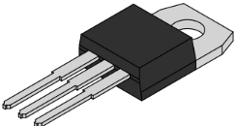
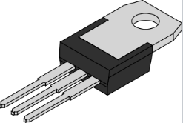
TO 220 package
The TO‑220 is a through-hole package designed for moderate to high-power electronic components. It features a plastic body with three leads (though variants with up to seven leads exist) and a distinctive metal tab often with a mounting hole—for attaching the device to a heat sink.
The TO-220 package is used for high-power components that are mounted through holes on a circuit board, with 2.54 mm spacing between the pins.

Slide 62
TO 220 package
The TO‑220 is a through-hole package designed for moderate to high-power electronic components. It features a plastic body with three leads (though variants with up to seven leads exist) and a distinctive metal tab with a mounting hole for attaching the device to a heat sink.
Thermal Design & Heat Dissipation: The metal tab allows the package to be bolted securely to a heatsink, enabling dissipation of tens of watts of heat.
Flexible electrical isolation options (insulated or bare tab).
Industry-standard footprint, simplifying board design and manufacturing.

Slide 63
THANK YOU !!

